Slide 1
可交互人工智能系统 Conversational AI Systems
Dr. Minlie Huang (黄民烈)
aihuang@tsinghua.edu.cn
http://coai.cs.tsinghua.edu.cn/hml/
AI Lab.
Dept. of Computer Science
Tsinghua University

Slide 2
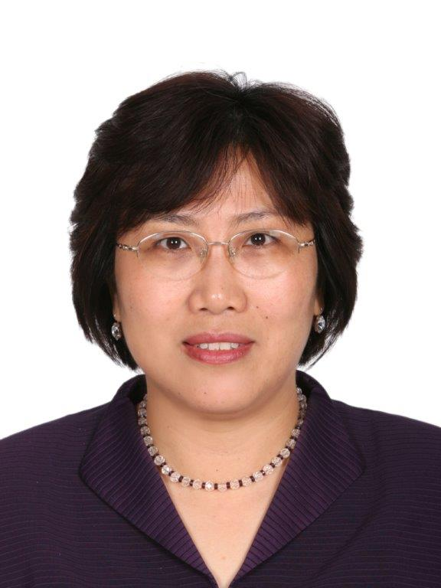
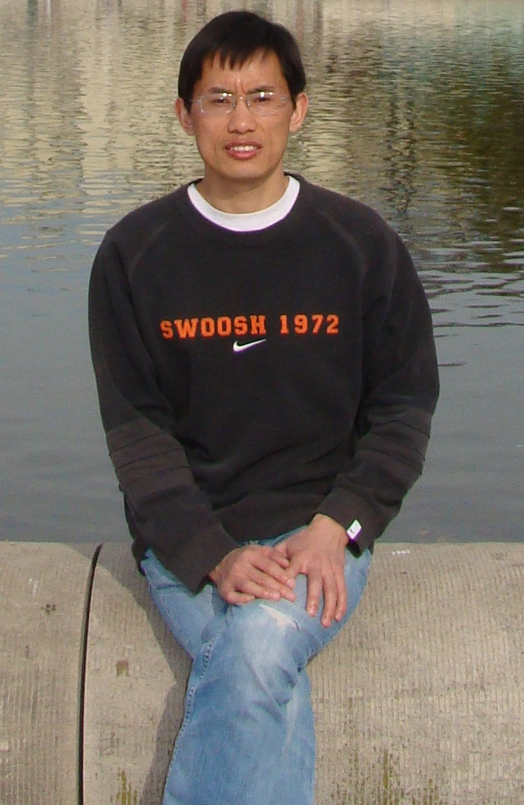
Conversational AI Group
Faculty
Prof. Xiaoyan Zhu
A/Prof. Minlie Huang
Students
8 PhD students
4 Master students
20+ Undergraduates
Meeting
Group seminar on Thursday
PhD seminar on Friday

Slide 3
Who am I (Minlie Huang)?
Dr. Minlie Huang
Associate Professor
Work at Tsinghua since 2006
Visiting professor at NIH, University of Hamburg, National University of Singapore
Research interests
Artificial intelligence
Deep learning in NLP
Deep reinforcement learning in NLP
Natural language processing
Dialogue systems, sentiment analysis

Slide 4
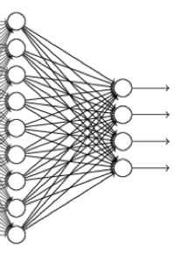
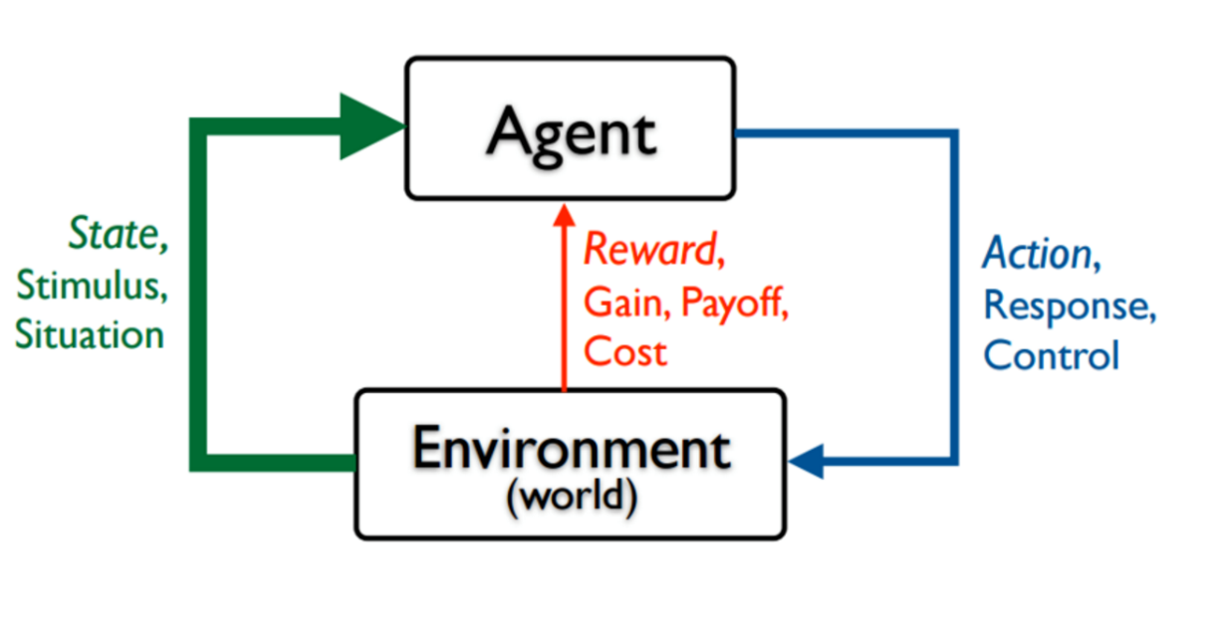
Research Interests ~~Theory
Deep Learning
Deep Reinforcement Learning
Machine Learning

Slide 5
Deep Reinforcement Learning
Exploration strategies
Unsupervised, Weakly Supervised, Auxiliary Tasks
Hierarchical RL, Action Hierarchy
Multi-task, Multi-agent, Collaborative/Adversarial
Reverse RL

Slide 6
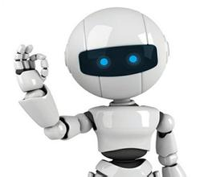
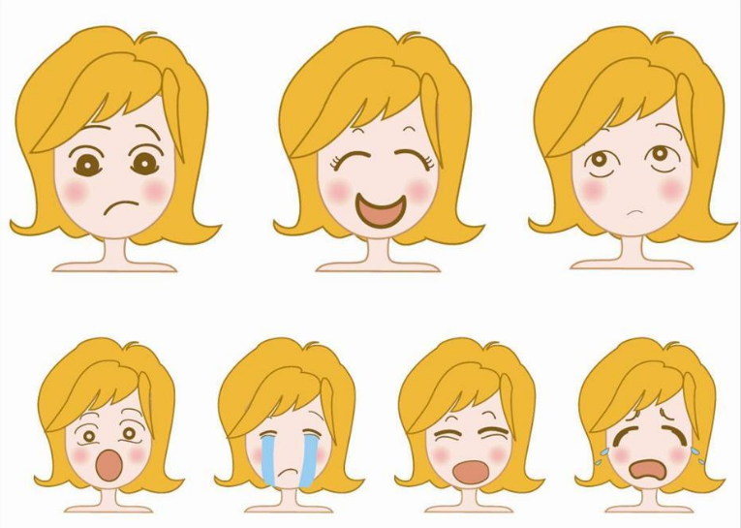
Research Interests ~~Applications
Question Answering, Dialogue Systems, Machine Comprehension
Logics, Reasoning in Language
Sentiment/Emotion Understanding
Language Generation

Slide 7

Question Answering in NLP
QA from structured source
KB QA
Table QA
QA from unstructured source
Reading Comprehension
How to …
represent questions/KB/documents
model reasoning process

Slide 8
Question Answering over KB
Q: How tall is Yao Ming?
A: He is 2.29m tall and is visible from space.
(Yao Ming, height, 2.29m)
Q: Which country was Beethoven from?
A: He was born in what is now Germany.
(Ludwig van Beethoven, place of birth, Germany)
Knowledge Bases
(Yao-Ming, spouse, Ye-Li)
(Yao-Ming, born, Shanghai)
(Yao-Ming, height, 2.29m)
… …
(Ludwig van Beethoven, place of
birth, Germany)
… …
Learning
Question Answering System
Q: How tall is Liu Xiang?
A: He is 1.89m tall

Slide 9
Question Answering over Tables
Q: How many people participated in the game in Beijing?
A: 4,200
Q: When was the latest game hosted?
A: 2012
year | city | #_days | #_medals
2000 | Sydney | 20 | 2,000
2004 | Athens | 35 | 1,500
2008 | Beijing | 30 | 2,500
2012 | London | 40 | 2,300
Learning
Q: Which city hosted the longest Olympic game before the game in Beijing?
Question Answering System
A: Athens

Slide 10
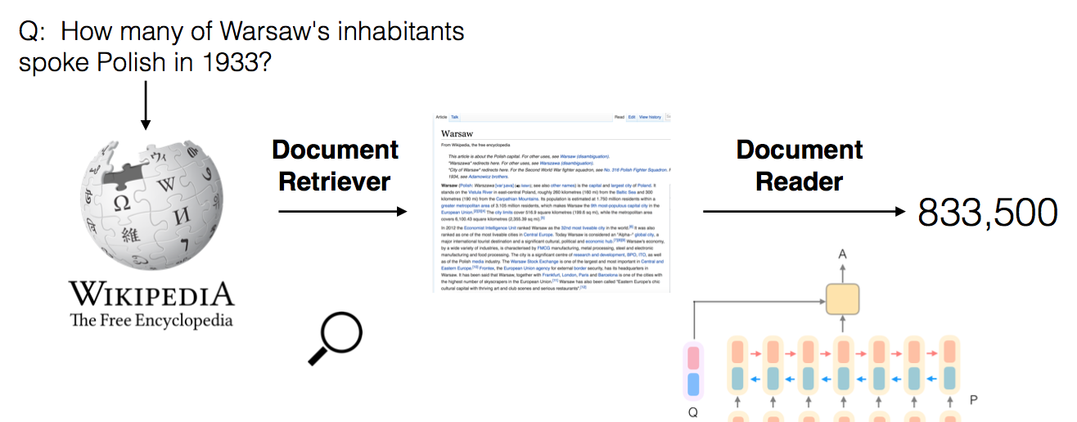
Question Answering over Documents
(Reading Comprehension)

Slide 11
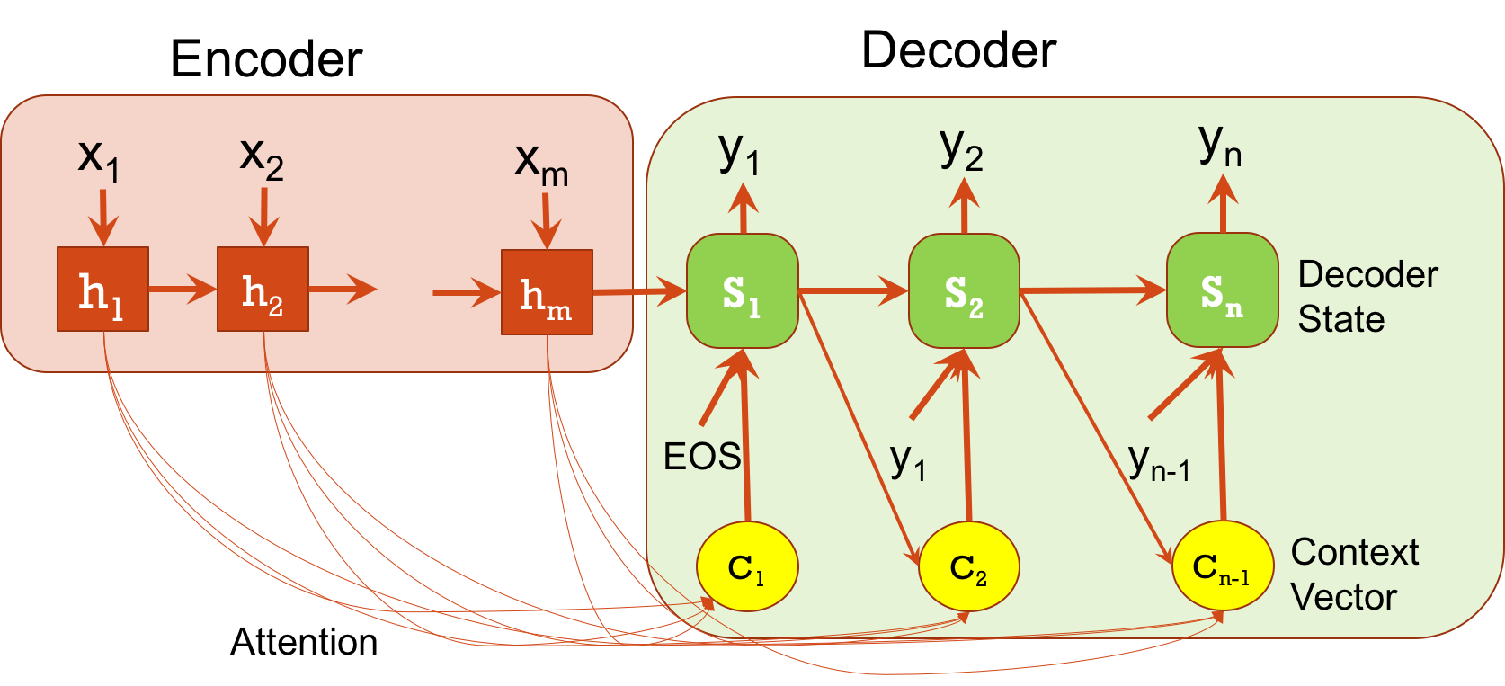
Open-domain Dialogue Systems
基于深度学习的对话生成
User: 今天杭州为什么这么热
System: 那你还来这干嘛？

Slide 12
Open-domain Chatting Examples
User：最幸福的人不是拿到了最好的东西，而是学会去珍惜手上已经拥有的人。
Machine: 是的，所以我也要珍惜自己的幸福
User: 时间啊，你这把杀猪刀。。。
Machine: 我是被杀的
User: 怕孤獨，又捨不下自己的小自由。
Machine: 我想去流浪，但没有人陪我去。
User: 雪，飘舞。人，行走。树，纯美。天，苍茫。城，安静。
Machine: 好美的意境
User: 欲享受选择之快乐必先经历选择之痛苦
Machine: 是的，人生就是这样，人生的意义就是选择。

Slide 13
Task/Goal Oriented Dialogue Systems
对话上下文
五道口附近有什么比较好的餐馆？
对话
意图分析
对话管理
知识库
全聚德烤鸭怎么样？
对话生成
推理与选择

Slide 14
Challenging Research Problems
Dialogue act analysis (intent)
What does the user want to do?
Dialogue management
What is the next that the user wants to do?
What is the next that the system wants the user to do?
Dialogue generation
The system knows what the user want to do, but how to prompt the user with a natural language?
End-2-end dialogue systems
Learning through conversation
Deep learning + reinforcement learning

Slide 15

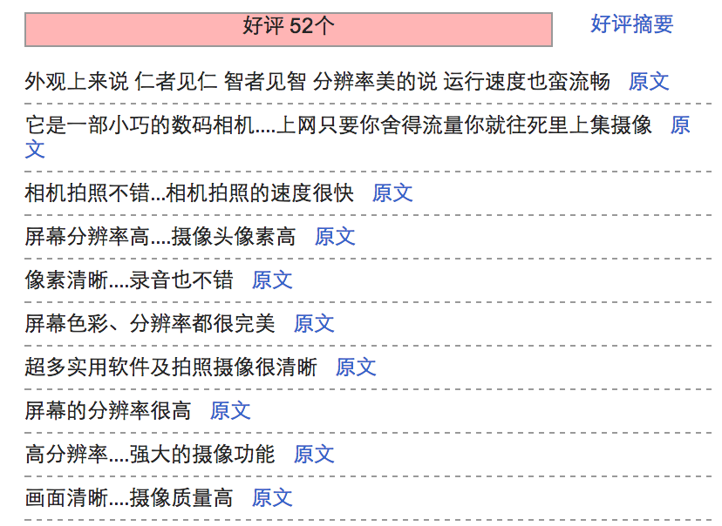
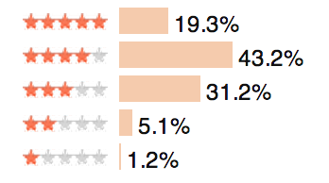
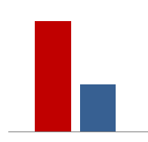
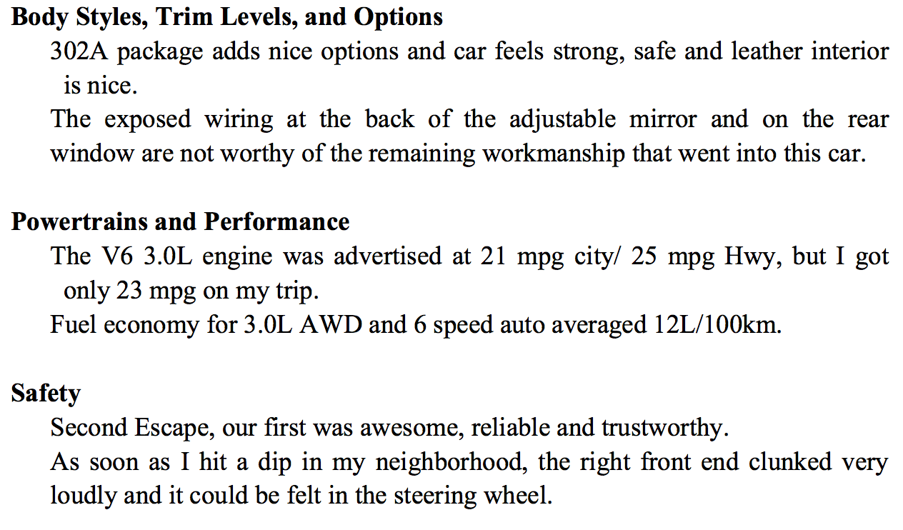
Sentiment/Emotion Understanding
‘Your brand is not what you say but what they say’!
Spam/Spammer Detection
IJCAI 2011
CIKM 2015
ACL 2014
EMNLP 2014
COLING 2010
Sentiment
Retrieval
Sentiment
Extraction
ACL 2009
AAAI 2016
ACL 2015
IJCAI 2015
CIKM 2014
CIKM 2013
ACL 2012
AAAI 2010
Sentiment
classification
Sentiment Rating
KAIS 2014
Sentiment
Summarization
-
+
JCST 2011
COLING 2010

Slide 16
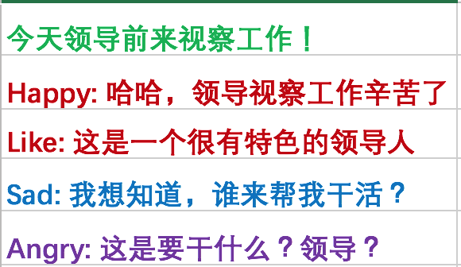
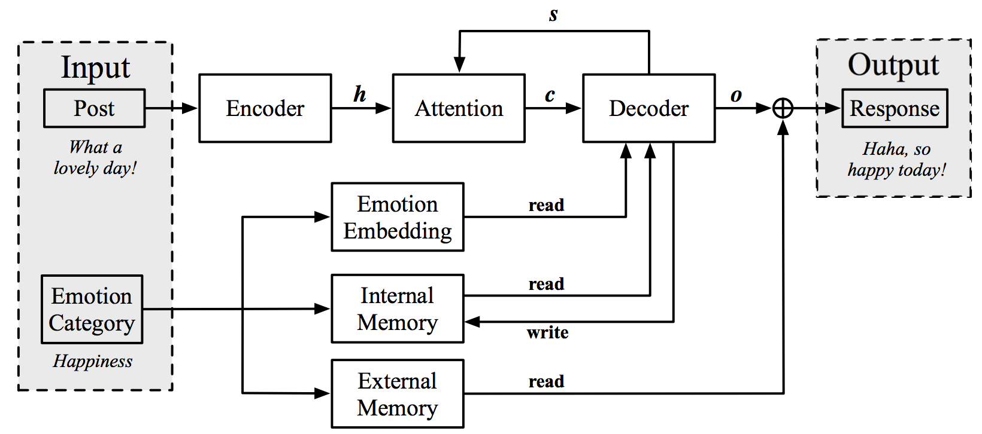



Emotional Chatting Machine
让计算机感知与表达情感、情绪，体现更高水平的智能
海量微博聊天语料
人工标注的情绪分类数据
发帖
回复
基于深度学习
情绪分类器
ECM：基于深度学习的情绪化内容生成
发帖
回复
发帖
回复
…
喜
怒
哀
…
相关工作被MIT Technology Review、英国卫报、参考消息、新华社等多家媒体报道
情感分析领域的顶级专家Prof Björn Schuller 认为我们的工作 “an important step” towards personal assistants that could read the emotional undercurrent of a conversation and respond with something akin to empathy.
Notes:
如何让计算机感知、表达情绪或情感，一直是AI的长期努力的目标。比如日本软银公司的情感机器人pepper，就曾经在市场上引起了极大的轰动。
我们研究了开放领域闲聊对话场景下如何让聊天机器人表达喜怒哀乐几种情绪化的内容。
首先，我们从社交媒体收集了大量的 用户之间的互动数据；
然后，我们训练了一个情绪分类器，对这些互动数据进行 喜怒哀乐的情绪标注；
最后，这些数据被送入到一个 基于深度学习的情绪化内容生成器，这样对于一个输入内容“今天领导前来视察工作”，可以生成不同情绪的回复，比如高兴的，悲伤的。。。。
我们的工作得到了媒体的关注，认为对于让机器表达情绪这个问题，是一个很重要的尝试。
Prof Schuller 是情感分析领域的顶级大牛，对我们的工作也有很高的评价。

Slide 17
Emotional Chatting Machine
情绪 | 早上的天气不错啊！哈哈哈哈哈哈
喜欢 | 今天的天气不错啊！
悲伤 | 天气好，心情不好。
厌恶 | 这是哪里啊？求解释
愤怒 | 怎么了？什么情况？
快乐 | 今天的天气真好啊！
情绪 | 送一个这样的蛋糕，给你美丽的闺蜜吧！
喜欢 | 好漂亮的蛋糕啊！
悲伤 | 为什么我觉得很恶心
厌恶 | 这样的蛋糕你忍心吗？
愤怒 | 有没有想开网店的？
快乐 | 哈哈，好可爱的蛋糕！
情绪 | 为了解决抄作业的不好习惯，高数老师这回要出绝招了！
喜欢 | 这老师太有才了！
悲伤 | 这样的老师伤不起啊
厌恶 | 这老师也太狠了点吧
愤怒 | 这老师是要逆天啊！
快乐 | 哈哈，这老师太有才了
情绪 | 承诺，就是一个骗子说给一个傻子听的。
喜欢 | 承诺是一个专一的傻子
悲伤 | 我就是一个悲伤的傻子
厌恶 | 一个骗子说给一个傻子听
愤怒 | 不管你信不信，反正我信了！
快乐 | 我就是一个开心的傻子
Hao Zhou, Minlie Huang, Xiaoyan Zhu, Bing Liu. Emotional Chatting Machine: Emotional Conversation Generation with Internal and External Memory. AAAI 2018.

Slide 18
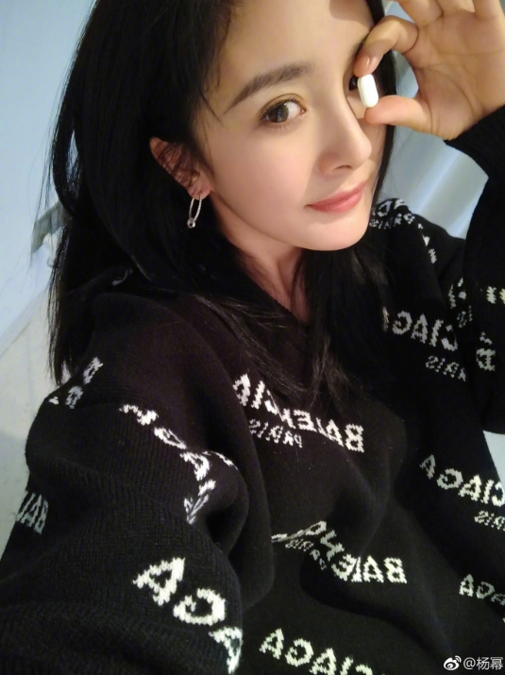
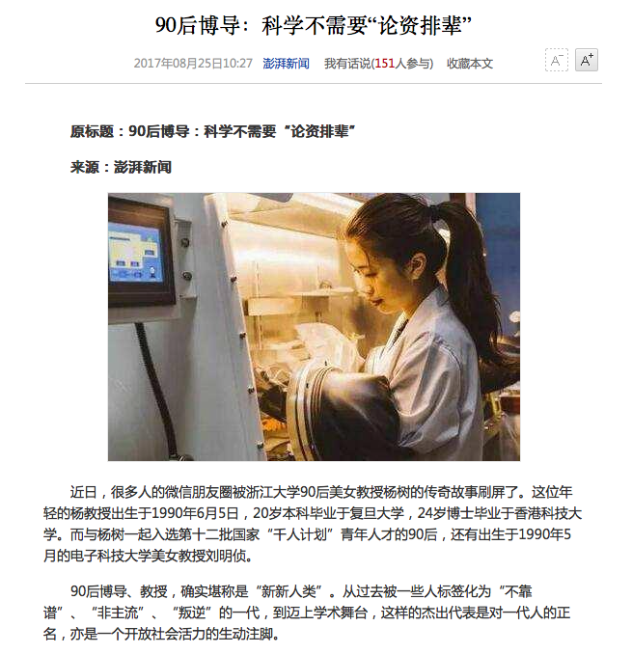
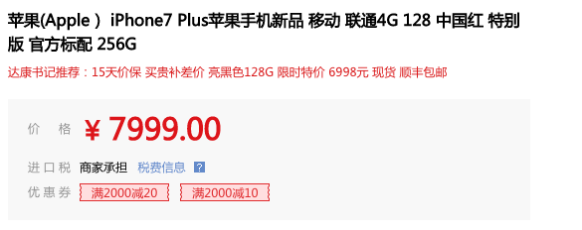
Language Generation (Review, Dialogue, Story, Long Text)
给图片生成评论
给新闻生成评论
“表白杨幂，爱你”
“90后太猛了”
“喜欢大幂幂的点赞”
“难度没有关系？”
“大幂幂坠美”
“我就不信这么厉害”
“价格也太坑爹了吧”
“这红色也是有点醉了”
“好吧，脑残果粉才会买吧”
(1)如何控制生成过程中的观点极性、情感情绪表达
(2)如何控制生成过程中的描述对象、话题、侧面
(3)长文本生成：如何控制逻辑、语义的连贯性

Slide 19
Recent Publications
NLP top conferences: ACL 2018(2), ACL 2017, ACL 2016(2), EMNLP 2016, ACL 2015, ACL 2014, EMNLP 2014, ACL 2012, ACL 2010, ACL 2009
AI top conferences: IJCAI (4), AAAI 2018(4), AAAI 2017, IJCAI 2016, AAAI 2016, IJCAI 2015, AAAI 2012,IJCAI 2011
Data Mining conferences: WWW 2018, CIKM 2014, CIKM 2013, CIKM 2012, ICDM 2012, ICDM 2009, ICDM 2008
Best papers
COLING 2010 best paper
ACL 2012 best student paper
SDM 2014 Best Student Paper Runnerup
NLPCC 2015 best paper

Slide 20
Undergraduate First-author Papers
Wenjie Wang: SIGIR 2018 (山东大学大三)
Tianyang Zhang: AAAI 2018 (计53)
Gaoxin: IJCAI-ECAI 2018 (计55)
Yansen Wang, Chenyi Liu: ACL 2018 (计55)
Tianji Yang: AAAI 2018 (北理工大三)
Qiao Qian: ACL 2015
All are top conferences, first-author

Slide 21





Where did our Graduates Go？
Former Inter. Students:
Mattia Tomasoni (Italy, ACL 2010)
Jameir Patrick (France)
5 hired by Google(USA,Switzerland)
5 hired by IBM(USA, England, CHN)
4 hired by Microsoft(USA,CHA)
3 hired by Baidu
2 hired by Sogou
One is university faculty of USA

Slide 22



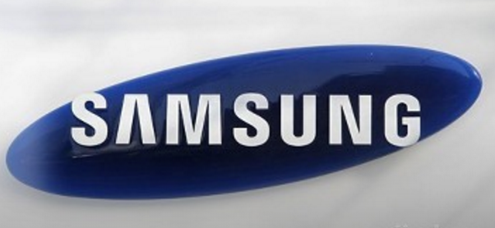



Collaborators and Partners

Slide 23
Recruiting PhD Students 招募博士生
Fully self-motivated, Hard-working, Learning quickly
Love to do research, perhaps to be faculty in the future
Contact me (不要犹豫):
aihuang@tsinghua.edu.cn
Tel: 18901155050
http://coai.cs.tsinghua.edu.cn/hml/

